Slide 1
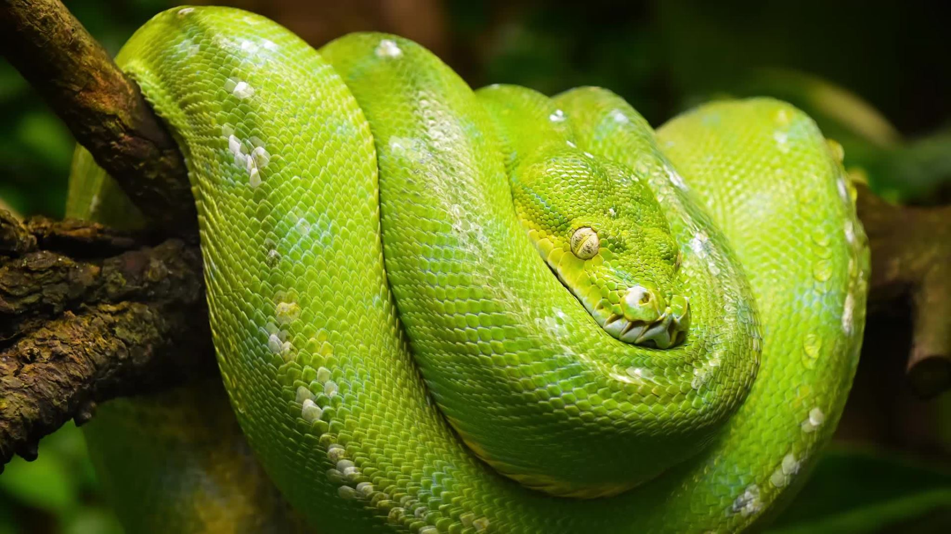
Python Programming

Slide 2
Creation of Python
Guido van Rossum.
Begin developing the program in the early 1990's
Open Sourced
Focus on code readability and simplicity
Scripting Language
“Python is an experiment in how much freedom program-mers need. Too much freedom and nobody can read another's code; too little and expressive-ness is endangered.”

Slide 3
Python as a Calculator
Add
Subtraction
Multiplication
Division

Slide 4
Variables
A variable is a named reference to a value that can be stored, retrieved, and manipulated during the execution of a program. It acts as a container that holds a data value and allows you to refer to that value by its assigned name.
How most variables are written in Python.
Lowercase (Lower and uppercase words are two different variables)
Snake_case (Underscores used between words)
camelCase (Words are concatenated together. The first letter is lowercase, and the rest are capitalized)

Slide 5
Get Operator =
Assignment operator
Used when we assign a variable.
Gets.
= and == are not the same.

Slide 6
Variable Types
What can a variable hold? (Number, word, character, etc.)
Integer – whole number (int)
Floating-Point Number – decimal number (float)
String (str)
Boolean (bool)
Many other types (list, tuple, dict, set)
Python is Dynamically typed – meaning that you can change the type of input. Some languages the types are static – meaning you can't change the type after it has been declared.

Slide 7
Variable Lab
Open up IDLE
Make a variable called (message) and write Hello World!.
Make a variable called (my name) and then write your name in quotes.
Make a variable called age and then write your age.
Make up a variable name for the number of people in your family and then write the number. Use Camle Case for the variable.

Slide 8
Lab Examples
message = "Hello, World!"
my_name = "John Doe"
age = 45
myFamilyCount = 5

Slide 9
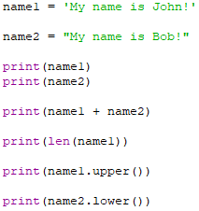
Strings
Single Quotes 'Hello, World!'
Double Quotes "My name is John"
Concatenation
Calculate length ---------- len("My name is John.")
Many other methods(lower, upper, split, joiin, etc.)

Slide 10
Print Methods/Formatting
Print()
print("Hello, world!")
print(message)
F-String
name = "John"
age = 25
Print(f'My name is {name} and I am {age} years old.')
My name is John and I am 25 years old.

Slide 11
Printing Lab
Open Printing Lab File.
Use the Print() Function to print the variable message.
Use the F-String method to produce the following output:
Hello my name is {Use name variable} and I'm {use age variable} years old. I have {Use family count variable} in my family.
Previous example
Print(f'My name is {name} and I am {age} years old.')

Slide 12
Lab Examples
message = "Hello, World!"
my_name = "John Doe"
age = 45
myFamilyCount = 5
print(message)
Print(f'My name is {my_name} and I am {age} years old. I have {myFamilyCount} in my family.')

Slide 13
Getting Input
Getting input from the user (Input command)
Num = input("Enter a number")
When you use the input command it becomes a string.
num1 = input("Enter first number: ")
num2 = input("Enter second number: ")
num1 + num2

Slide 14
Input Lab 1
Open up Idle.
Create a variable to get the number of students in a class.
Create a variable to get the number of teachers in a class.
Create a variable that takes the two inputs and adds them together.
Print out the results.

Slide 15
Input Lab 2
Create a variable called pizza and ask the user for what their favorite type of pizza. pizza= input("What is your name?")
Create a variable called pizza_number and ask the user how many pizzas they would like to order.
Create a variable called total_cost and multiply the total_cost by the pizza_number.
Use the F-String method to produce the following output:
Your favorite pizza is {pizza}. The total cost of your order is {total_cost}.

Slide 16
Lab Examples
cost_of_pizza = 7.5
pizza = input("What is your favorite type of pizza?")
pizza_number = input("How many pizzas would you like to order?")
pizza_number = int(pizza_number)
total_cost = cost_of_pizza * pizza_number
print(f'Your favorite pizza is {pizza}. The total cost of your order is ${total_cost}.')

Slide 17
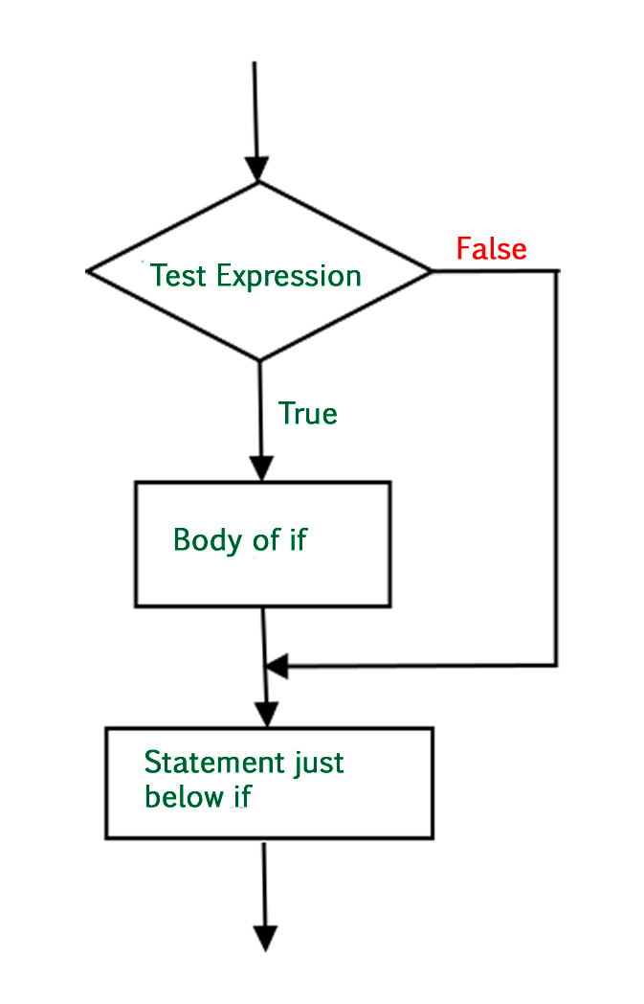
If Statement
Based on a Condition
If value is true then do this.
A colon is needed at the end of the if.
It will jump to the next line.
If(x < 5):
print(f'{x} is less than five')

Slide 18
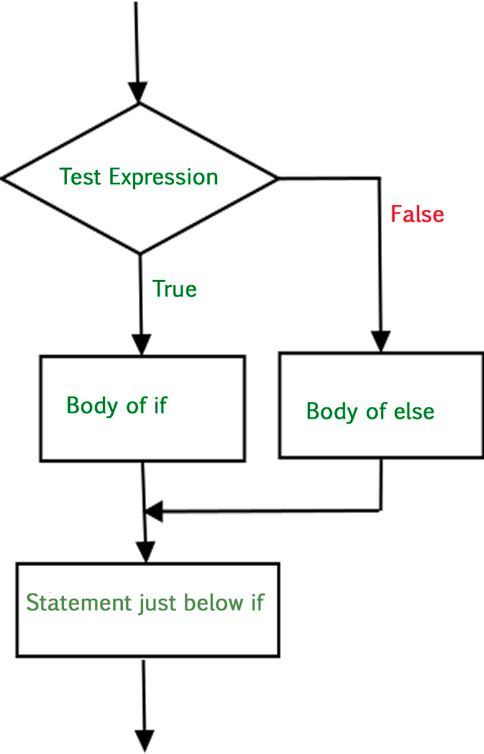
Else Statement
If the value is false than do this.
If(x < 5):
print(f'x is less than five')
Else:
Print(f'{x} is not less than five.')

Slide 19
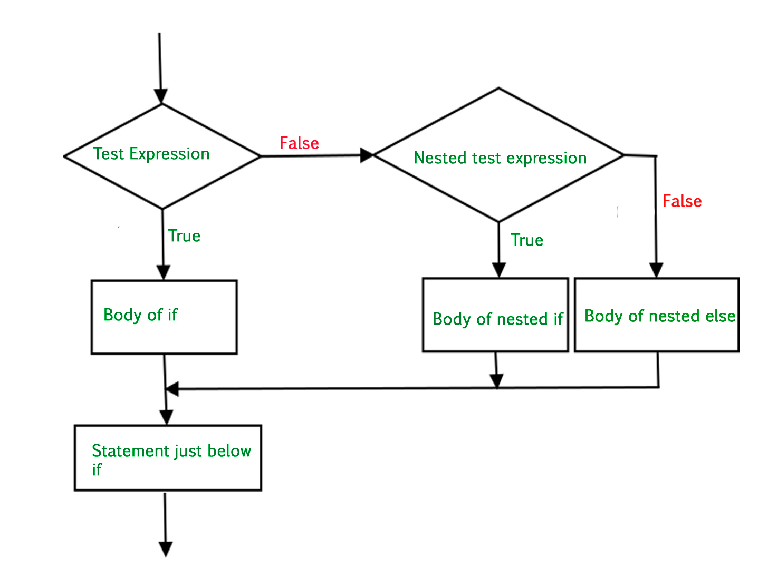
Elif Statement
If the first value is false than do this.
You can have multiple elif's.
End if with else.
if x < 5:
print(f'{x} is not less than 5')
elif x == 5:
print(f'{x} is equal to 5')
else:
print(f'{x} is greater than 5')

Slide 20
Grading If Sample
>= 90
>= 80
If Grade >= 90 == A.
You got an A. Good Job!
If Grade >= 80 == B.
You got a B. You're doing fine.
If Grade >= 70 == C.
You got a C. You did Average.
If Grade >= 60 == D.
You got a D. You need to improve.
Else == F.
You got a F. You didn't pass. Please try harder!
>= 70
>= 60
< 60

Slide 21
If Lab 1
A principle has several classrooms that have a limited number of seating. The max seating is 30 students. Create an if statement that checks if the number of students that signed up for the class exceeds the number of seats available. If the number exceeds 30 then write that the number of students exceeds the classroom space. If it is less than or equal to 30 then state that the number is below the maximum capacity. Include how many open spaces are available.

Slide 22
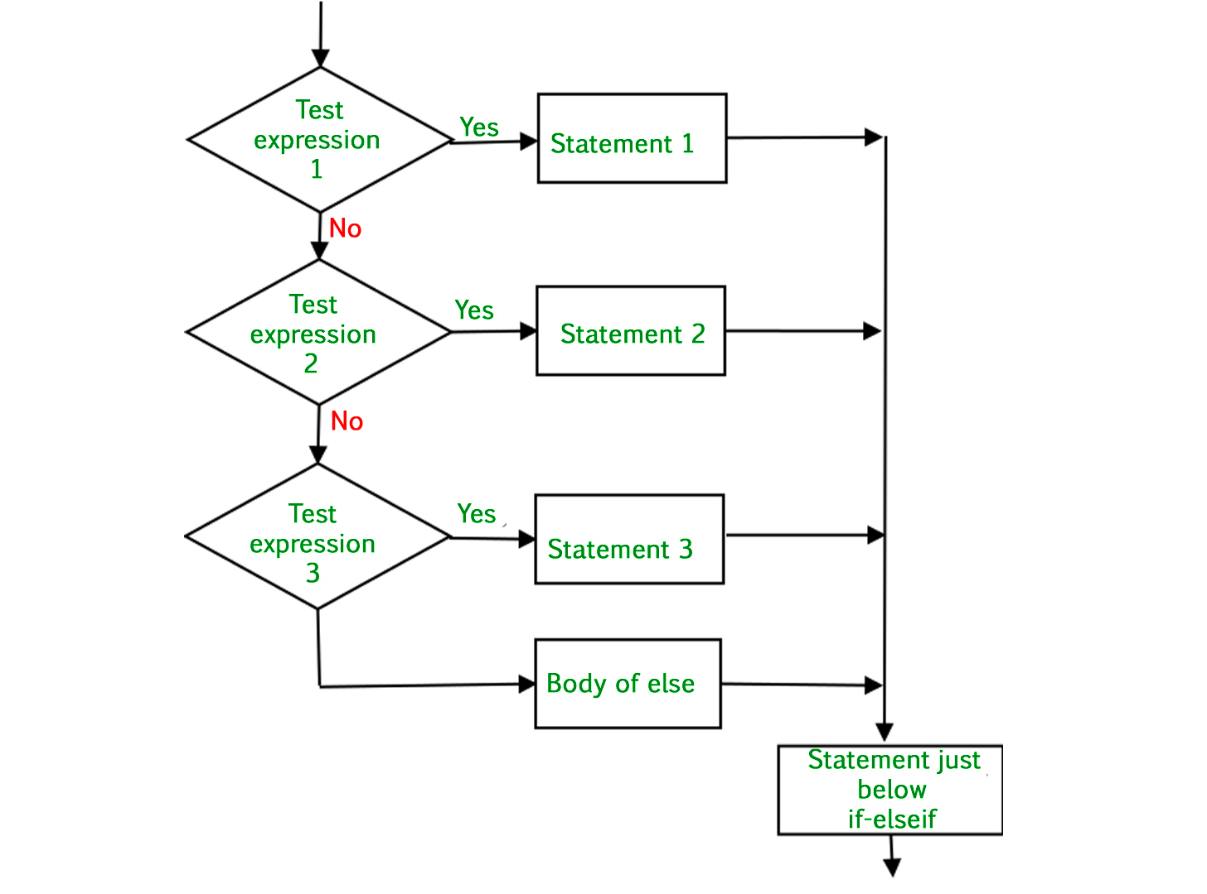
If Statement Lab
Create a variable called pay and assign it the value 15.
Create a name variable and assign it the value of 50.
Example: john = 30, bob = 40, tom = 50
Write a nested if statement that checks how many hours they worked.
If they worked less than 40 hours produce the following output:
John worked {john} hours. His net pay is 450 dollars. He is below the 40 hour work week.
If they worked 40 hours produce the following output:
Bob worked {bob} hours. His net pay is 600 dollars. He worked the standard work week.
If they worked more than 40 hours than calculate the amount and add the overtime pay they would get. Overtime would be the hours over 40 multiplied by 1.5.
Tom worked {tom} hours. His net pay is 825 dollars. He worked 10 hours of overtime.
Hint: Create a variable called overtime.

Slide 23
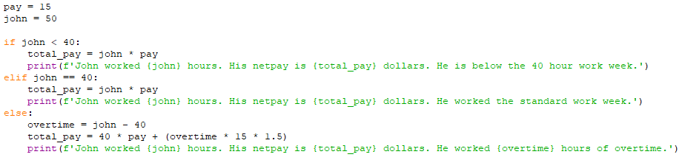
Lab Example

Slide 24
Error Handling
What are the primary uses of error handling?
Prevents the program from crashing.
It is helpful in debugging and troubleshooting.
Give the user a friendly experience.
Helps with Maintainability and Robustness.
Helps with error recovery.

Slide 25
Simple Error Handling
How to make sure that the user enters a whole number.
if int(number) == True:
print(f'{number}is a whole number.')
else:
input(f'{number} is not a whole number. Please enter a whole number: ')

Slide 26
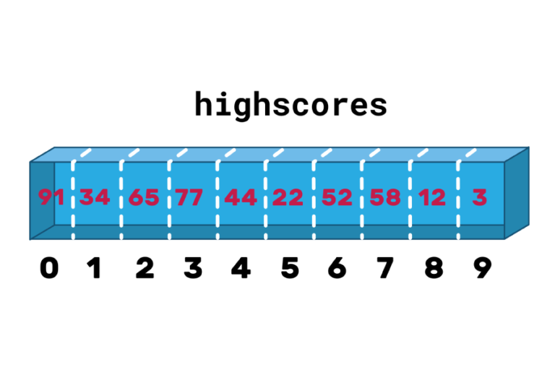
Lists/Arrays
A list (also called an array) is a tool for storing data, just like a variable. However, whereas a variable can store one piece of data at a time in a named location, a list can store many. futurelearn.com
Things to keep in mind when using a list?
The first value is at index 0.
You're able to modify the value in a list.
You can have multidimensional arrays.
You will get an error if you try to get a value outside the list.
Python has multiple ways to extract value.

Slide 27
How To Create A List In Python
age_list = []
age_list = [15, 20, 10, 6, 85, 50, 30]
names = ["Bob", "Tom", "Bill", "David"]
values = ["Adam", 10, 20, 4.5, "Mathew"]

Slide 28
How Extract Values In A List
age_list = [15, 20, 10, 6, 85, 50, 30]
print(age_list[0])
print(age_list[-1])
print(age_list[1:3])
print(age_list[3:])
print(age_list[:2])
print(age_list[15]) Error

Slide 29
Appending/Deleting/Inserting
shopping_list = ["Milk", "Bannas", "Oil", "Butter", "Trash Bags"]
Append
shopping_list.append("Paper Plates")
Deleting
shopping_list.remove(1)
Inserting
shopping_list.insert(0, "Chicken")

Slide 30
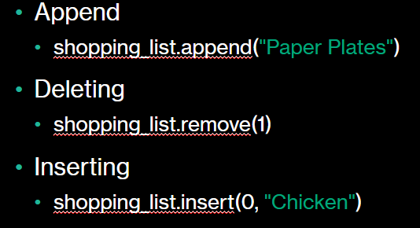
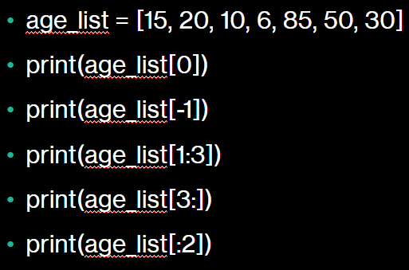
List Lab
Use this list and do the following commands.
countries = ["United States", "Canada", "United Kingdom", "Germany", "France", "Japan", "Australia", "Brazil", "India", "China"]
Print Brazil from the list.
Print China from the list.
Print the last three indexes.
Print index 3 to 7.
Add a new country to the list.
Delete United States from the list.
Insert the South Korea at index 7.

Slide 31
Lab Example
# Print Brazil from the list ---------- print(countries[7])
# Print China from the list --------- print(countries[9])
# Print the last three indexes -------- print(countries[-3:])
# Print index 3 to 7 --------- print(countries[3:8])
# Add a new country to the list ----------- countries.append("New Zealand") print(countries)
# Delete United States from the list --------- countries.remove("United States") print(countries)
# Insert South Korea at index 7 ------------- countries.insert(7, "South Korea") print(countries)

Slide 32
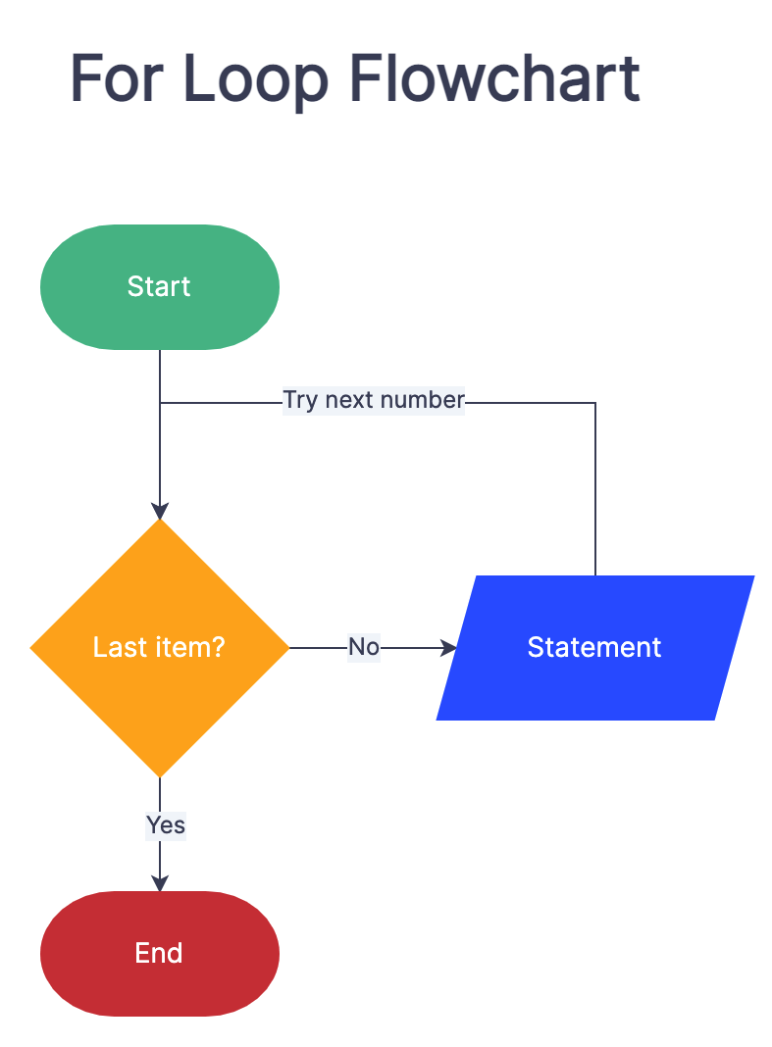
For Loop
In Python, a for loop is a control flow statement that iterates over a sequence of elements, such as a list, tuple, string, or any other iterable object. It allows you to perform a set of instructions or operations for each element in the sequence.
https://www.zenflowchart.com/blog/for-loop-flowchart

Slide 33
in Keyword
Allows you to check if an item is in a list.
names = ["Alice", "Bob", "Charlie", "David", "Eve", "Frank", "Grace", "Hannah", "Isabella", "Jack"]
name = input("Enter a name: ")
if(name in names):
print(f'{name} is already in the names list')
else:
names.append(name)

Slide 34
in Keyword Continued
Check if a substring exists in a string.
string = "Python is a powerful programming language."
if "programming" in text:
print("Substring found!")
else:
print("Substring not found.")

Slide 35
Writing a For Loop
states = ["California", "Texas", "New York", "Florida", "Illinois", "Pennsylvania", "Ohio"]
for state in states:
print(state)
total = 0
numbers = [10, 50, 80, 30, 40, 100, 78, 20]
for number in numbers:
total += number
print(total)

Slide 36
For Loop Lab 1
Open up the for loop practice file and write a for loop that will count how many times the word 'Technology' appears in the paragraph.
*** Note the word technology may be upper or lower case so you will want to use the lower() command to make it lowercase.
Example. "Text".lower()

Slide 37
Lab Example
for word in words: if word.lower() == word_to_count.lower(): count += 1 print("The word 'technology' appears", count, "time(s) in the paragraph.")

Slide 38
For Loop Lab 2
Open up For Loop Lab 2.
You have a list of two lists. fruits = ['apple', 'banana', 'cherry'] and colors = ['red', 'yellow', 'pink']
Write a for loop that produces all possible combinations between the two lists.
Hint. You will use more than one for loop.

Slide 39
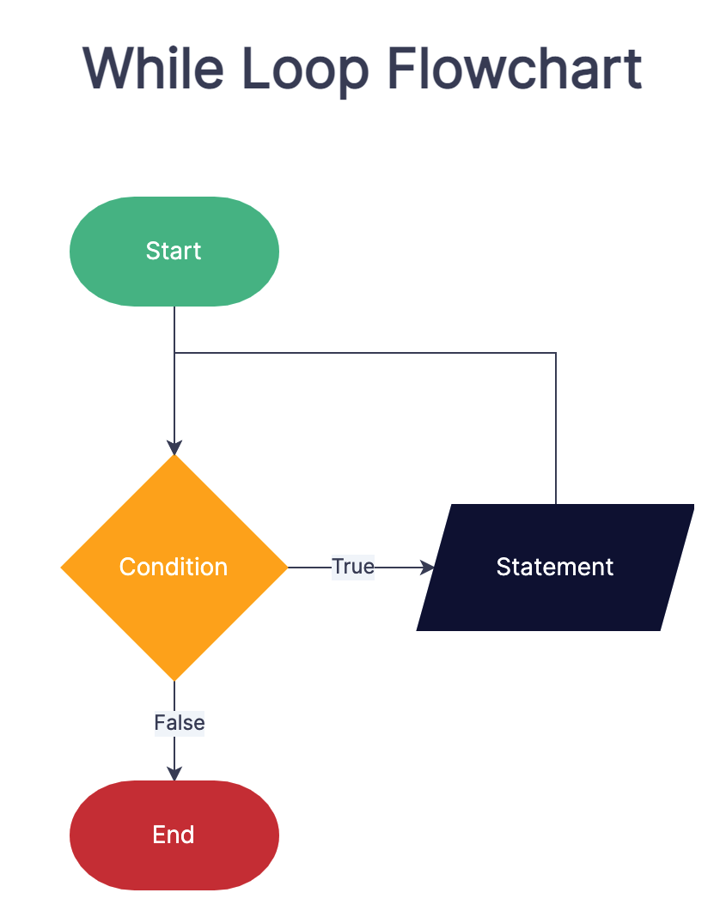
While Loop
A while loop is a control flow statement that allows you to repeatedly execute a block of code as long as a certain condition remains true. It provides a way to create a loop that continues until a specified condition is no longer met.

Slide 40
How to Write a While Loop
x = 5
y = 10
while x < y:
print(f'{x} is less than {y}')
y -= 1
print(y)

Slide 41
Infinite While Loop
x = 5
y = 10
while x < y:
print(f'{x} is less than {y}')
print(y)
How to fix this issue.
Ask the user for input.
Put in a break once a certain condition is met.

Slide 42
Uses of a While True Statement
Input validation. Keep prompting the user for the correct input.
Continuous execution. You may want to continue running a program until a certain event happens.
array = [4, 5, 22, 99, 0, "t"]
while True:
for item in array:
if type(item) == int:
print(item)
break

Slide 43
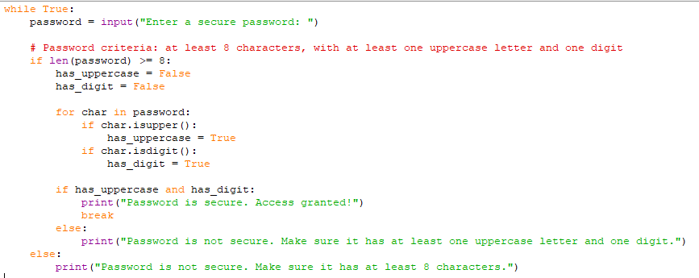
While True Password Sample

Slide 44
While Loop Practice
Use a while True loop that asks the user to enter a whole number that is greater than 0.
Write the following prompts when the user enters the wrong input.
You entered a number less than zero.
You entered an incorrect response.

Slide 45
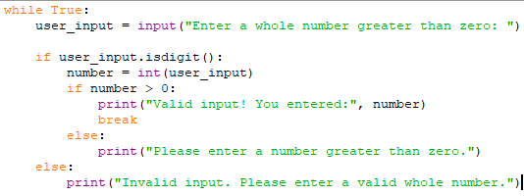
Lab Example

Slide 46
Functions
A function is a named block of reusable code that performs a specific task. Functions are a fundamental concept in programming languages, including Python. They allow you to break down a program into smaller, more manageable pieces, each responsible for a specific functionality.

Slide 47
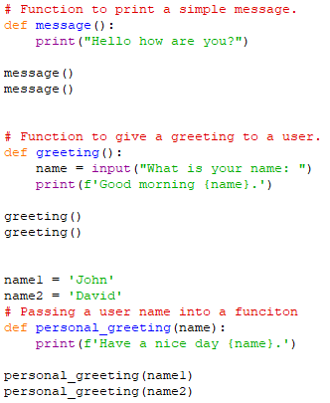
Simple Functions
You can call a function multiple times.
You can create variables within a function.
You can pass variables into a function.

Slide 48
Function Lab
Create a function to convert Fahrenheit to Celsius.
celsius = (fahrenheit - 32) * 5/9
Call the function twice and print out the results for 50, 89 degrees.

Slide 49
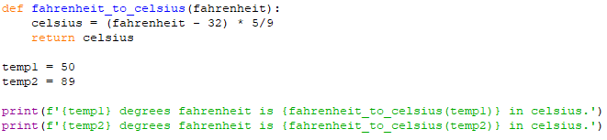
Lab Example

Slide 50
Importing
Importing in Python allows you to bring external modules or libraries into your code, making their functionality available for use. When you import a module, you gain access to its functions, classes, and variables, enabling you to leverage their capabilities in your program.
Common modules to import.
Random
Math
CSV
Datetime
Third Party Modules

Slide 51
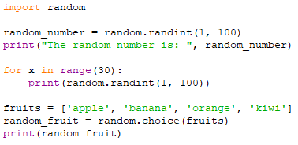
Random Number Generator

Slide 52
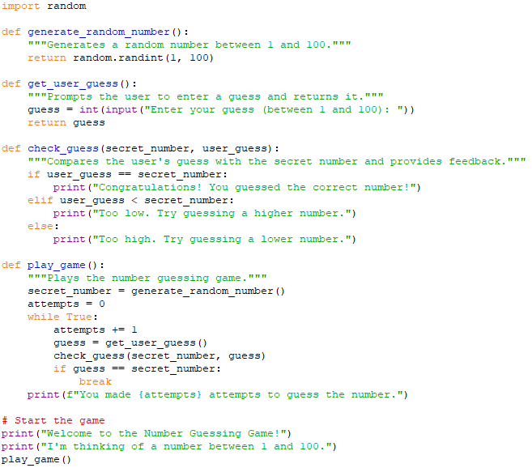
Number Guessing Game

Slide 53
GUI Programming
GUI programming, or Graphical User Interface programming, refers to the process of creating software applications that have a visual interface allowing users to interact with the program using graphical elements such as windows, buttons, menus, text fields, and images.

Slide 54
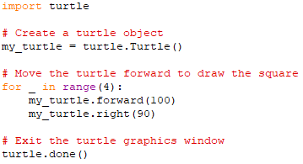
Turtle

